Slide 1

APEX INSTITUTE OF TECHNOLOGY
DEPARTMENT OF COMPUTER SCIENCE & ENGINEERING
DEEP LEARNING (20CSF-432)
Faculty: Prof. (Dr.) Madan Lal Saini(E13485)
Lecture – 8
Gradient descent,
Stochastic Gradient descent
DISCOVER . LEARN . EMPOWER

Slide 2
Deep Learning: Course Objectives
COURSE OBJECTIVES
The Course aims to:
Understand the key features in a neural network’s architecture
Understand the main fundamentals that drive Deep Learning
Be able to build, train and apply fully connected deep neural networks
Know how to implement efficient CNN or RNN.
Implementation the fundamental methods involved in deep learning, including the underlying optimization concepts (gradient descent and backpropagation) and how they can be combined to solve real-world problems.

Slide 3
COURSE OUTCOMES
On completion of this course, the students shall be able to:-
CO1 | Understand neural network, its working and parameters, and various deep neural network architectures.
CO2 | Differentiate between the major types of neural network architectures (multi-layered perceptron, convolutional neural networks, recurrent neural networks, etc.) and what types of problems can be solved by these architectures.
CO3 | Evaluate the performance of deep neural network and improve the performance by applying optimization techniques.
CO4 | Design or select neural network architectures for new data problems based on their requirements and problem characteristics and analyse their performance.
CO5 | Describe some of the latest research being conducted in the field and open problems that are yet to be solved.

Slide 4
Unit-1 Syllabus
Unit-1 | Artificial Neural Network
Fundamentals of Neural Network | Introduction to Neural Network, Model of Artificial Neuron, Multilayer Perceptron, Back Propagation, Learning rules and various activation functions, Gradient descent, Stochastic Gradient descent.
Neural Network Architecture | Single layer Feed-forward networks. Multi-layer Feed-forward networks. Architecture of Back-propagation (BP) Networks, Backpropagation Learning.
Training Neural Network | Training Deep Neural Networks using Back Propagation-Setup and initialization issues, Gradient- Descent Strategies, vanishing and exploding Gradient problems, regularizations, and dropouts.

Slide 5
SUGGESTIVE READINGS
TEXT BOOKS:
T1: Deep Learning with Python by Francois Chollet, Publisher: Manning Publications
T2: Deep Learning from Scratch: Building with Python from First Principles by Seth Weidman published by O`Reilley
T3: Deep Learning by Ian Goodfellow, Yoshua Bengio and Aaron Courville published by MIT Press.
REFERENCE BOOKS:
R1 Fundamentals of Deep Learning: by Nithin Buduma, Nikhil Buduma and Joe Papa, OREILLY Publication, Second Edition.
R2 Deep Learning: A Practitioners Approach by Josh Patterson and Adam Gibson, OREILLY Publication.
R3 Deep Learning for Coders with fastai and PyTorch by Jeremy Howard and Sylvain Gugger, OREILLY Publication.
R4 Deep Learning Using Python by S Lovelyn Rose, L Ashok Kumar, D Karthika Renuka, Wiley Publication

Slide 6
Course Objectives
To introduce soft computing concepts and techniques of artificial neural networks, fuzzy sets, fuzzy logic and genetic algorithms
To understand the various techniques from the application point of view.
To analyze various soft computing techniques and decide the technique to be used in a particular problem situation.
To implement soft computing based solutions for real-world problems

Slide 7
Course Outcomes
CO1 | Identify and describe soft computing techniques and their roles in building intelligent. Machines | 1
CO2 | Recognize the feasibility of applying a soft computing methodology for a particular problem. | 2,4
CO3 | Apply fuzzy logic and reasoning to handle uncertainty and solve engineering problems, genetic algorithms to combinatorial optimization problems and neural networks to pattern classification and regression problems. | 3
CO4 | Effectively use modern software tools to solve real problems using a soft computing approach. | 3
CO5 | Evaluate various soft computing approaches for a given problem. | 4

Slide 8
Table of Contents
Learning Rules

Slide 9
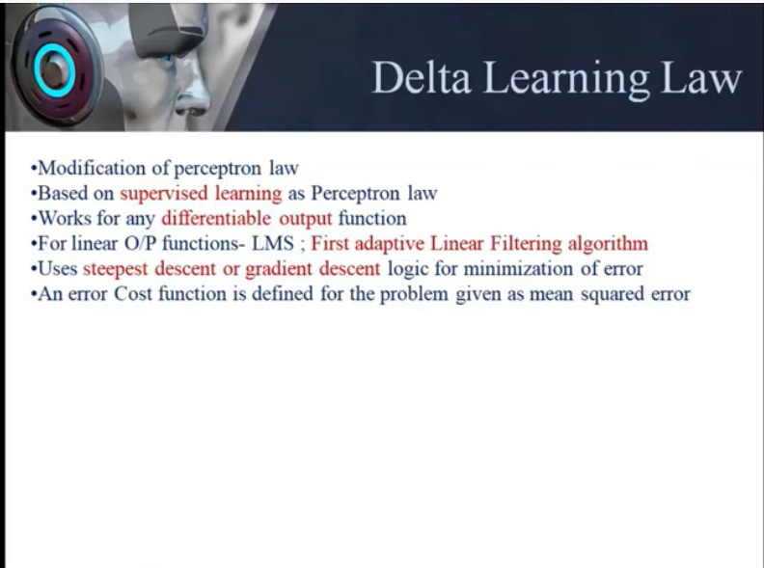

Slide 10
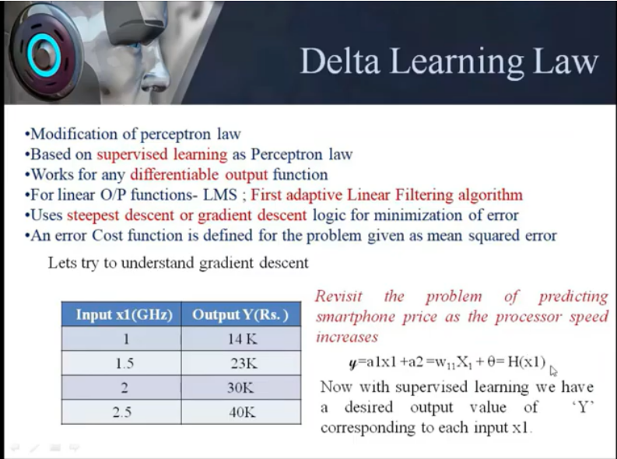

Slide 11
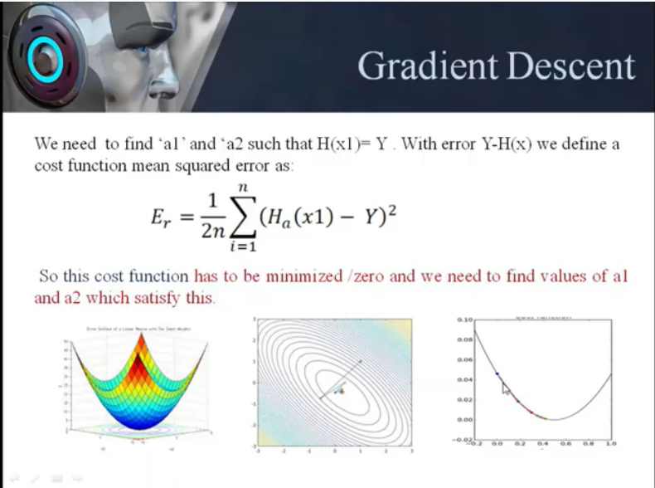

Slide 12
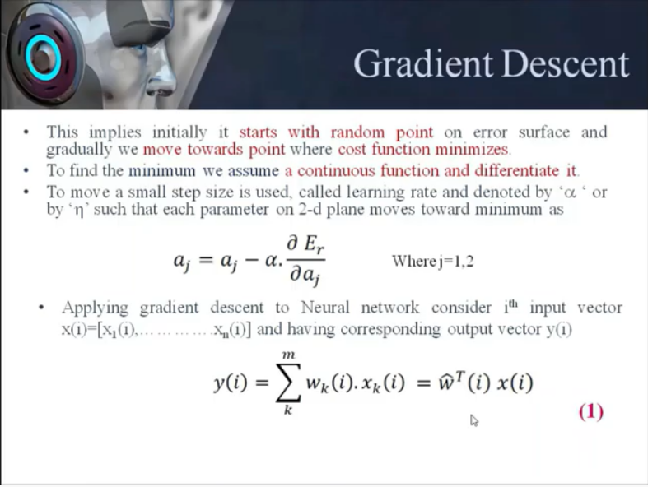

Slide 13
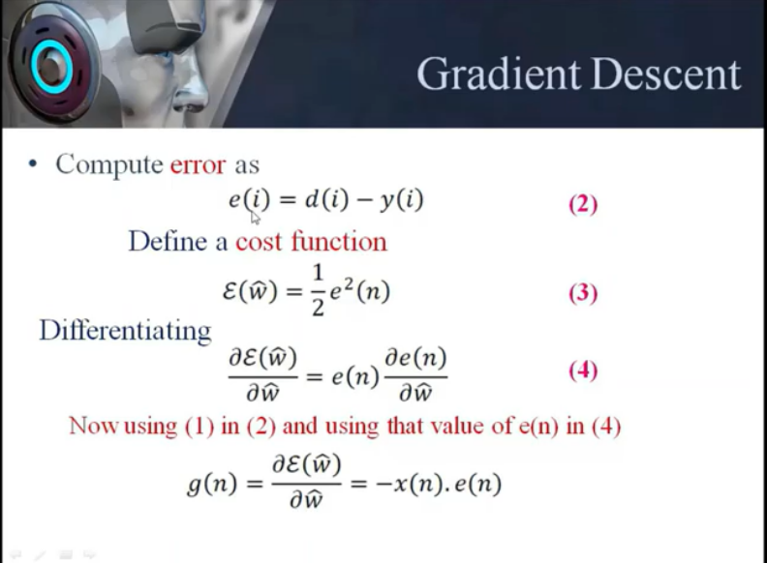

Slide 14
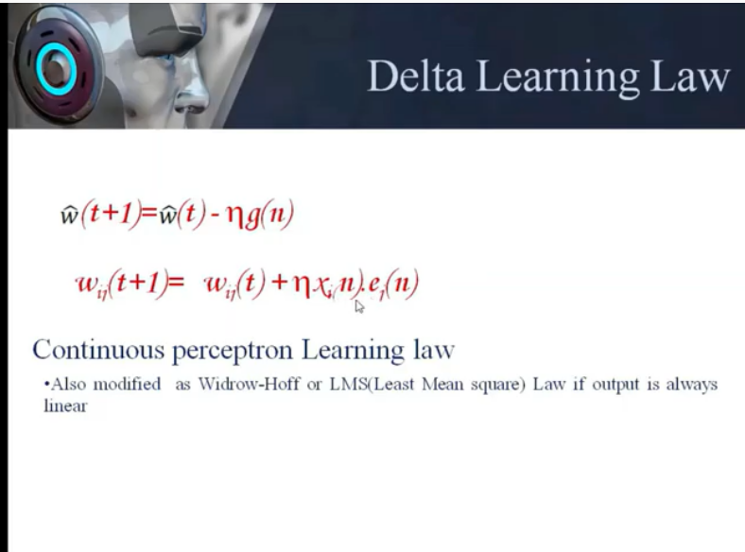

Slide 15
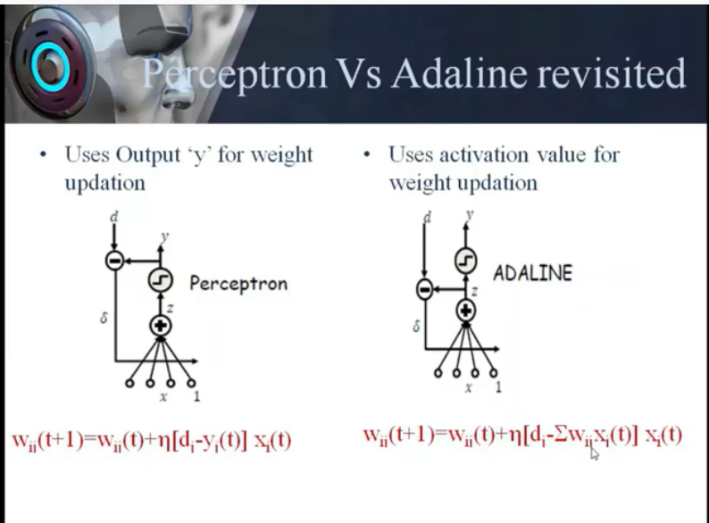

Slide 16
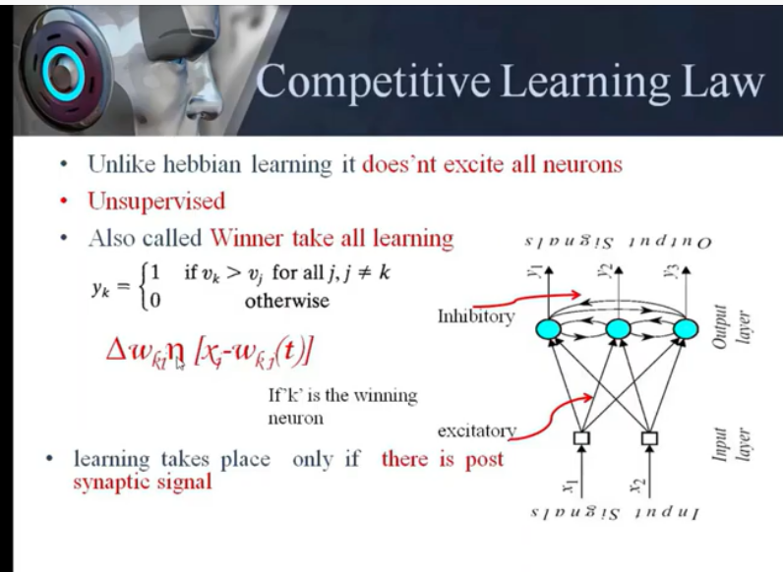

Slide 17
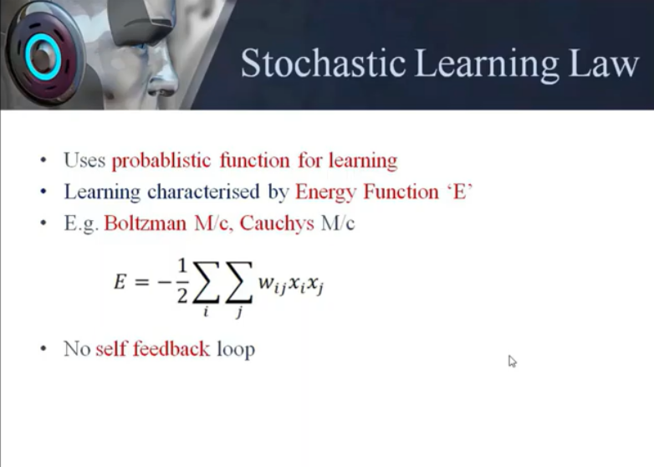

Slide 18
References
Book:
Deep Learning with Python by Francois Chollet, Publisher: Manning Publications
Journal Paper : https://www.sciencedirect.com/science/article/pii/S2405844018332067
Websites:
https://nptel.ac.in/courses/106/105/106105173/
MultiLayer Perceptron Learning Algorithm
http://www.cs.usyd.edu.au/~irena/ai01/nn/8.html
http://www.doc.ic.ac.uk/~nd/surprise_96/journal/vol4/cs11/report.html

Slide 19
THANK YOU
For queries
Email: madan.13485@cumail.in

